Slide 1

Coffee Shop Sales Analysis

Slide 2

Team
Sarah Elsaghier
Sara Gamil
Rania Abdelrahman
Remon Magdy

Slide 3



Agenda
Introduction
Business Questions
Data Modeling
Data Analysis & Dax Measures
Data Visualization
KPIs
Recommendations

Slide 4

Introduction
This presentation showcases an in-depth analysis of a coffee shop’s sales performance. Using Power BI, the dashboard highlights key metrics, trends, and insights to guide decision-making.
Data :we used Coffee Shop data from the last 6 months, which consists of an Excel file with 11 columns and 149117 rows.
The coffee shop has 3 branches and sells 9 product categories and 29 products.

Slide 5
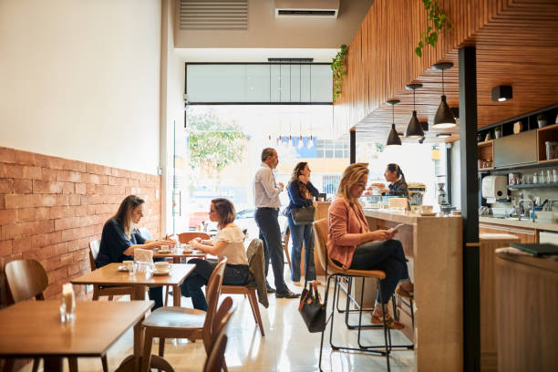
Business Questions
How are quantity distributed across The Products type?
What is the Average Daily Sales by product type?
How does the Transactions Growth over time?
What are the Top 5 Best Transactions Product Category ?
What are the Revenue trend over Time?
How are Revenue distributed across stores?
What are Total revenue over time interval?
How are sales affected by product price ?
What is the best selling product ?
What is the total revenue over six months ?
What is the number of transactions over six months?
What is the total Units sold over six months ?

Slide 6
Queries
A "Revenue" column was added to the "Transactions" table to calculate revenue by multiplying the values in the "Unit Price" and "Quantity" columns.
The "Stores," "Products," and "Dates" tables were extracted from the "Transactions" table.
The "Month Name," "Day Name," and "Days" columns were extracted from the "Transaction Date" column.
A "Time" column was extracted from the "Transaction Time" column, then converted from 12-hour format to 24-hour format.
A "URL Image" column was added, containing an image for each "Product Category."

Slide 7
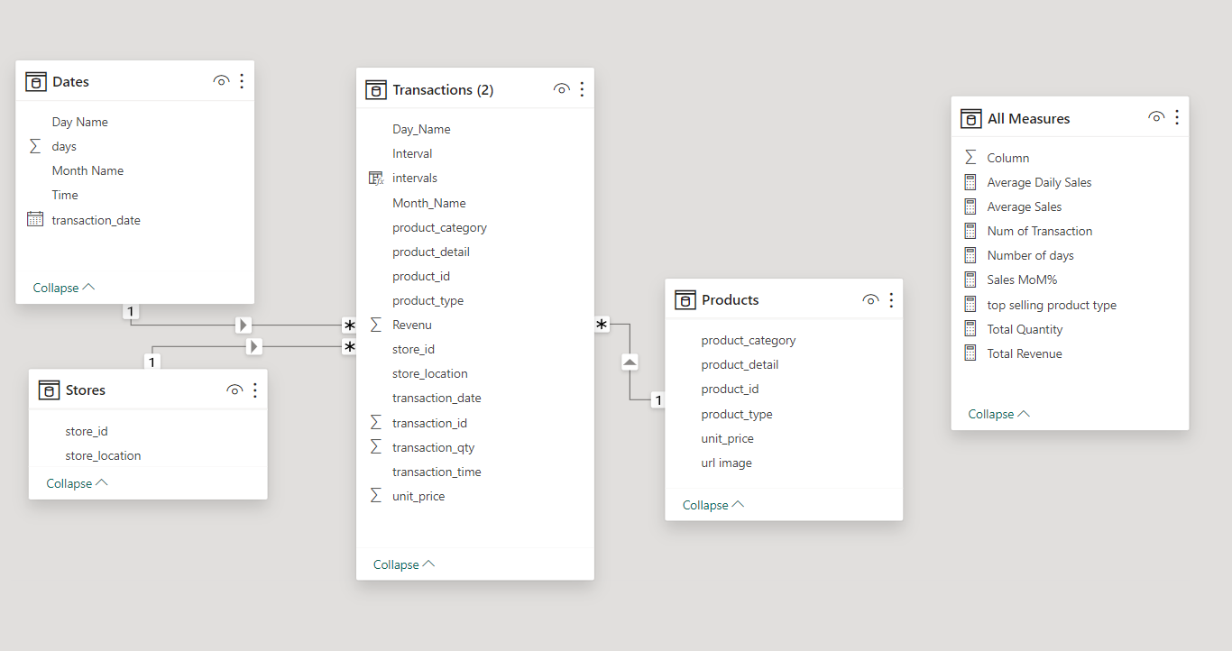
Data Modeling

Slide 8

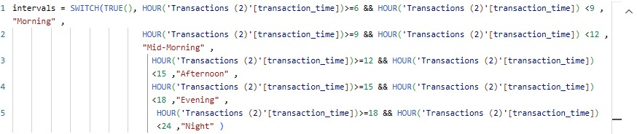
DAX Measures

Slide 9


Slide 10
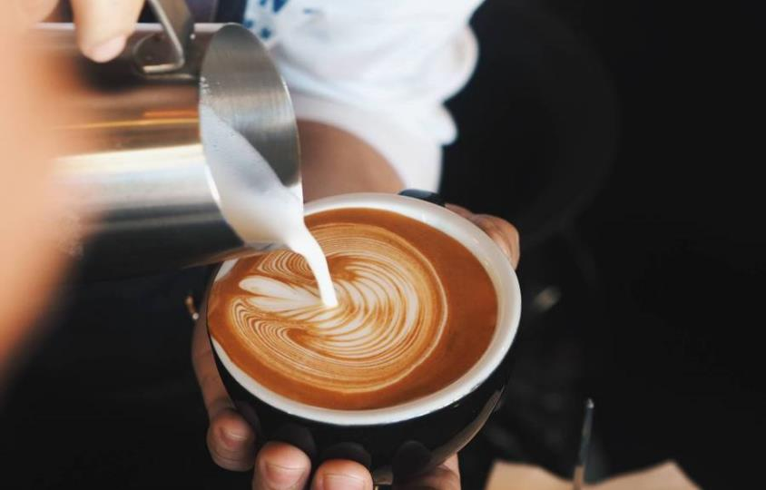
KPIs
Revenue Trends: Revenue peaked at $166K in June but has declined by February.
Peak Sales Periods: Mid-morning generates the highest sales, with $0.22M in revenue.
Product Categories: Coffee leads with 58K transactions, followed by tea and bakery.
Store Performance: Hell's Kitchen and Lower Manhattan contribute equally to total sales, each generating around $231K.
Transaction Growth: Sales are consistent through the week but dip slightly on Sundays.

Slide 11

Recommendations
Optimize Store Performance: Focus on promotional activities in underperforming stores to balance sales distribution and increase foot traffic.
Increase Morning Promotions: Leverage peak sales periods with morning specials and combo offers to boost revenue further.
Expand High-Demand Products: Prioritize stocking high-demand items like coffee and bakery products to meet customer preferences.
Monitor and Adjust Product Mix: Regularly review product performance and adjust the menu to reflect popular choices, especially during peak periods.
Targeted Marketing Campaigns: Use the data to design campaigns focused on high-demand times (mid-morning and evening) and promote best-selling items

Slide 12
Recommendations
6- Loyalty Program Implementation: Introduce or enhance a loyalty program that offers rewards for frequent customers, encouraging repeat business.
7- Staff Training for Peak Times: Ensure that staff are trained to handle high-demand periods efficiently, especially during mid-morning, to avoid bottlenecks.
8- Upselling Strategies: Train staff on upselling complementary products (e.g., pairing coffee with bakery items) to increase the average sales per transaction.
9- Product Bundling: Offer product bundles or combo deals during slower periods to drive sales and clear out less popular stock.
10- Operational Efficiency: Evaluate and streamline store operations to ensure consistent product availability and faster service during peak hours.

Slide 13

Thank you

